Slide 1
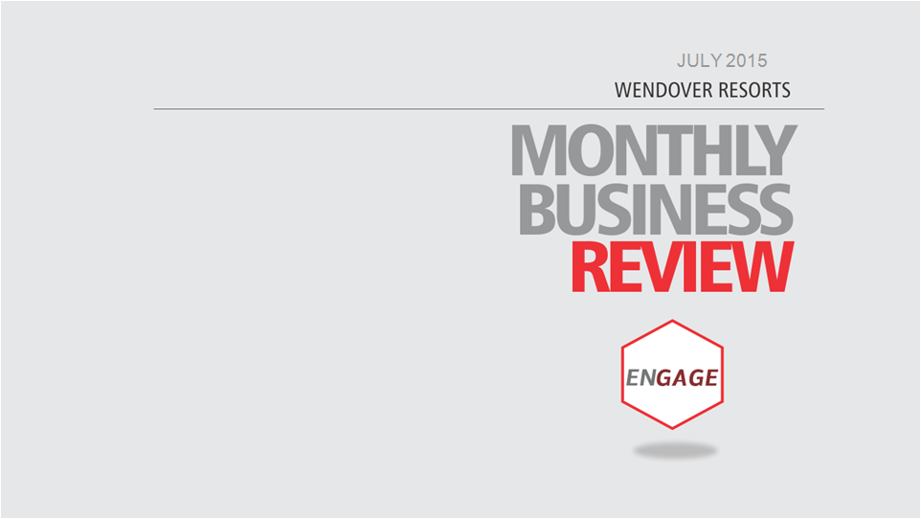

JUNE 2015
FEBRUARY 2017

Slide 2






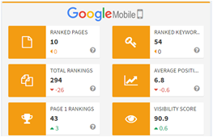



TOTAL RANKINGS
873
Ranking Profiler
Feb. 1-28, 2017
Ranking Profiler
AVE.
POSITION
5.5
VISIBILITY
SCORE
90.9%
Feb. 1-28, 2017
VISIBILITY
SCORE
95.1%
RANK PROFILER
AVE.
POSITION
6.8
RANKED PAGES
7
TOTAL RANKED PAGES
14
TOTAL RANKINGS
268
PAGE ONE
RANKINGS
46
PAGE ONE
RANKINGS
178
RANKED KEYWORDS
54
CHECKED KEYWORDS
211

Slide 3

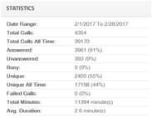
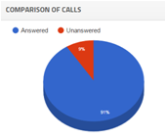
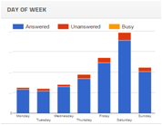
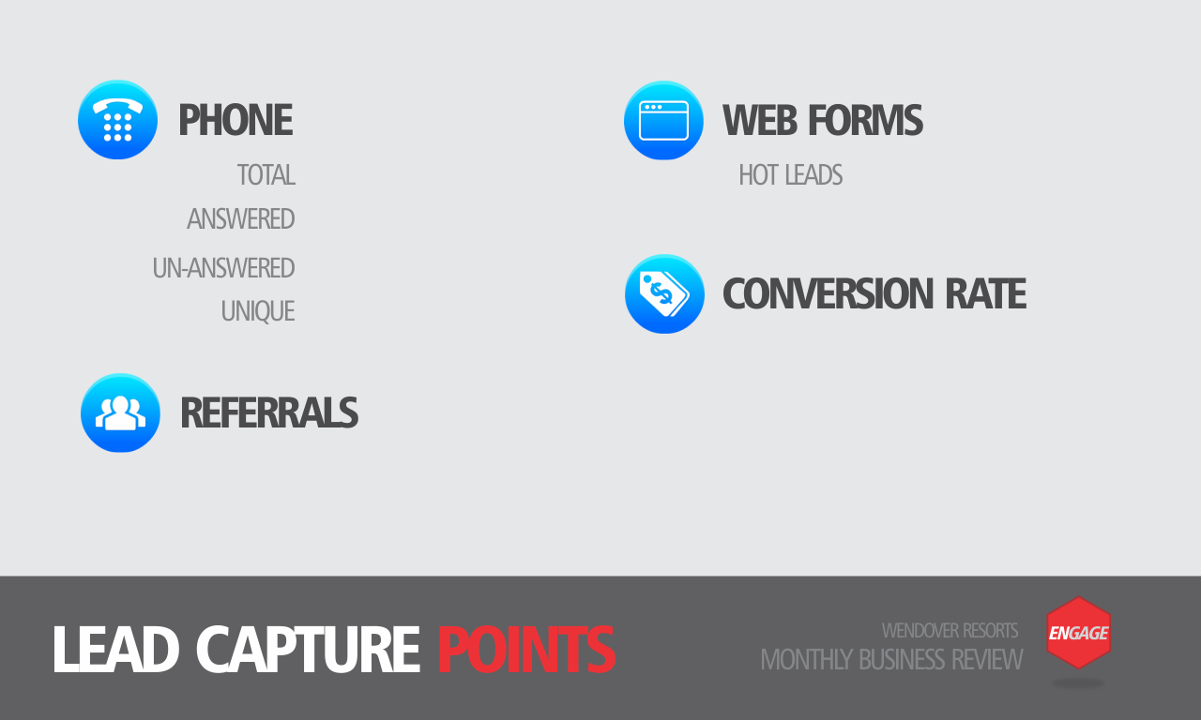
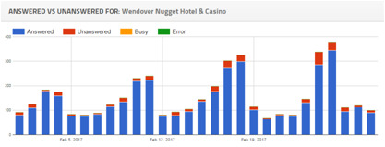


4,354
3,961
(91%)
393
(9%)
2,403
(55%)
506
COUPONS
64.67%
New Users per GA: 7,515.27
LEAD GENERATION

Slide 4
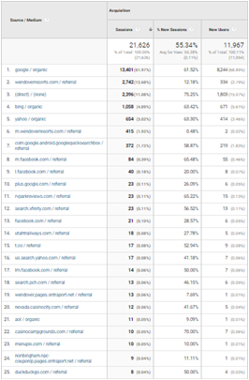
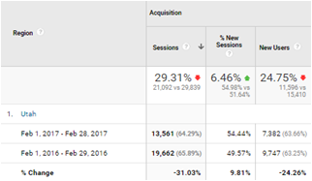



Comparison
Top 25 Acquisition
GOOGLE ANALYTICS

Slide 5
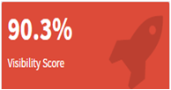
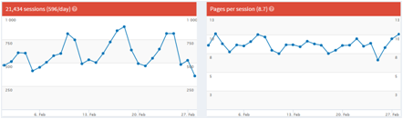
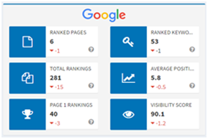
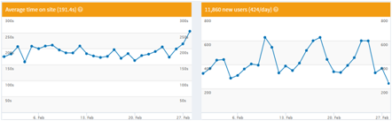


SEO PROFILE

Slide 6


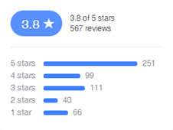
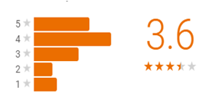
Reputation Management
100 %
Response Rate

Slide 7

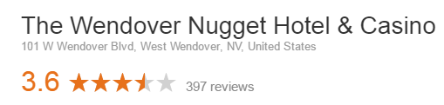









Wendover Nugget Hotel & Casino
Red Garter Hotel & Casino
61
36
6
1
REPUTATION MANAGEMENT

Slide 8




February 2017
VIEWS
686
EST. MIN. WATCHED
915
LIKES
6,775
1,305
LIKES
0
TWITTER FOLLOWERS
UNLIKES
29
IMPRESSIONS
14,200
DISLIKES
0
COMMENTS
0
IMPRESSION
PROFILE VISITS
1287
9,625,530
SHARES
3
1,873,344
46
REACH
NEW FOLLOWERS
VIDS IN PLAYLISTS
0
ENGAGEMENT
173,691
MENTIONS
47
0
SUBSCRIBERS
Tweets linking to You

Slide 9

Twitter Performance Overview
Key Metrics
Total Tweets | Total Retweets | Total Followers | Impressions
113 | 9 | 1,305 | 14,200
Twitter Followers
 | 1400 1300 1200 1100
 |  |  | 1,305
 |  | 1,252
 |  | Jan | Feb
Followers

Slide 10

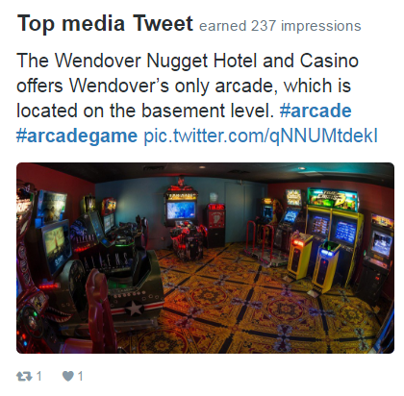
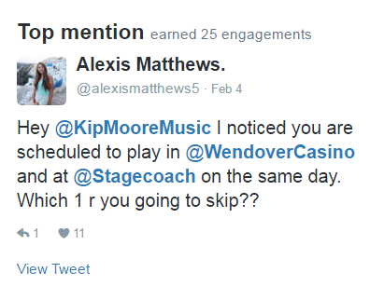
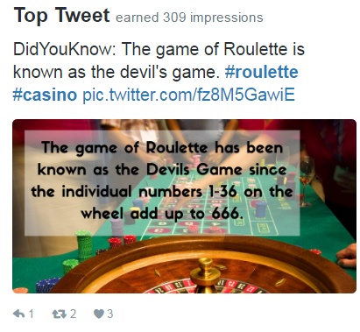
Tweet Highlights

Slide 11
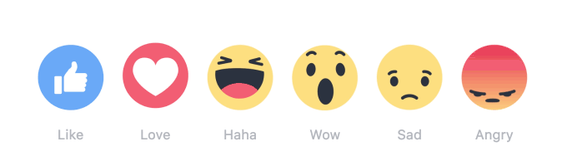

Facebook Performance Overview
Key Metrics
Total Page Likes | Organic Post Reach | Total Engagement
February Month | Potential number of users reached | Total engagements (Likes, Shares, Comments)
6,775 | 1,873,344 | 173,691
Facebook Likes
 | 6800 6700 6600
 |  |  | 6,775
 |  | 6,677
 |  | JANUARY | FEBRUARY
Page Likes

Slide 12



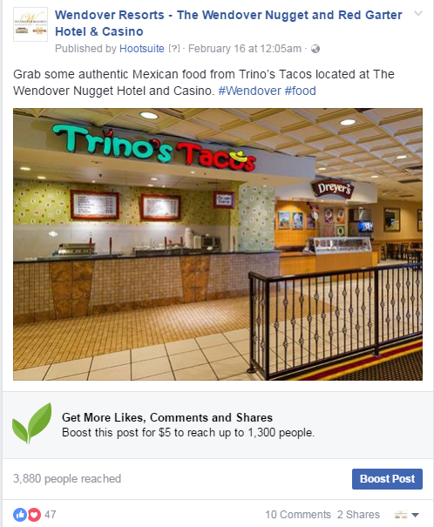
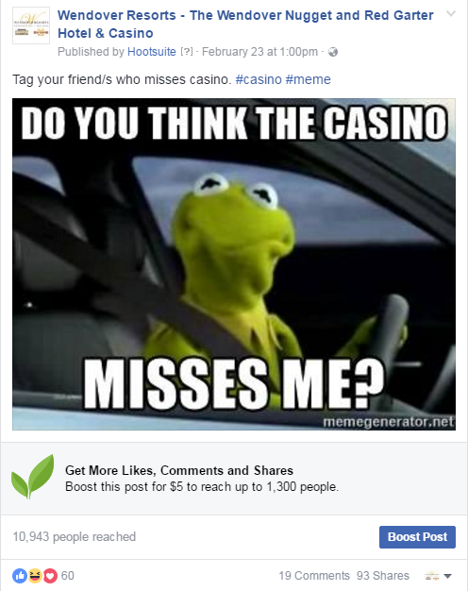
Facebook Top Post

